Slide 1
EEG Seizure Prediction Using Logistic Regression: Effects of Preprocessing, Regularization, and Class Imbalance Handling
Presented By: Shahid Azam
Student Number:
Supervisor Name:
Course:
Date:

Slide 2
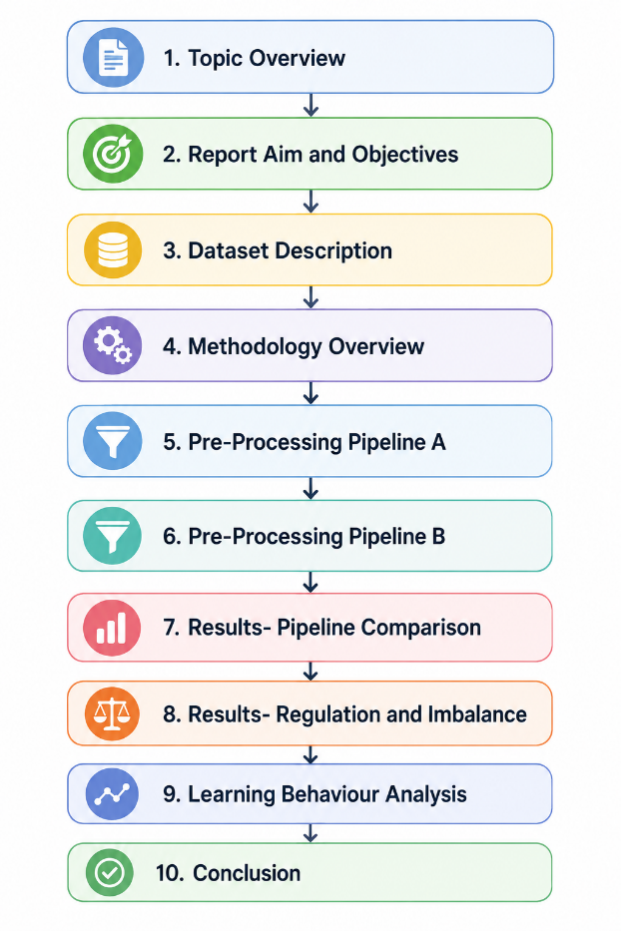
Presentation Outline
Topic Overview
Report Aim and Objectives
Dataset Description
Methodology Overview
Pre-Processing Pipeline A
Pre-Processing Pipeline B
Results- Pipeline Comparison
Results- Regulation and Imbalance
Learning Behaviour Analysis
Conclusion

Slide 3
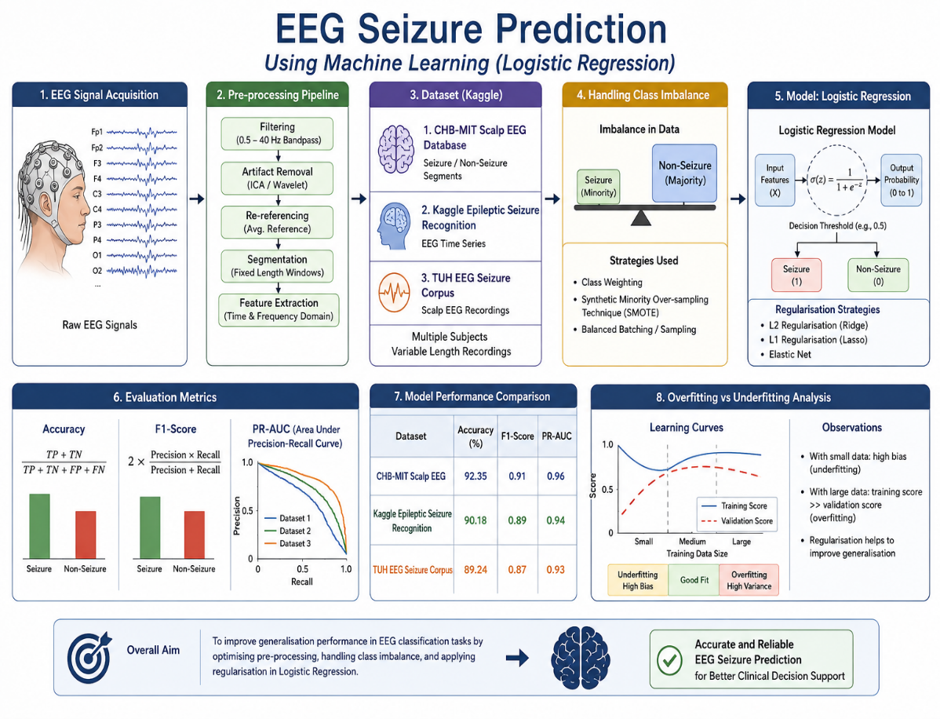
Topic Overview
This presentation focuses on EEG seizure prediction using machine learning techniques.
The study applies logistic regression to classify EEG signals into seizure and non-seizure states.
It investigates the effect of pre-processing pipelines, regularisation strategies, and class imbalance handling.
Three EEG datasets from Kaggle are used for experimental evaluation.
The work compares model performance using accuracy, F1-score, and PR-AUC metrics.
The research also analyses overfitting and under fitting behaviour in EEG models.
Overall, the study aims to improve generalisation performance in EEG classification tasks.

Slide 4
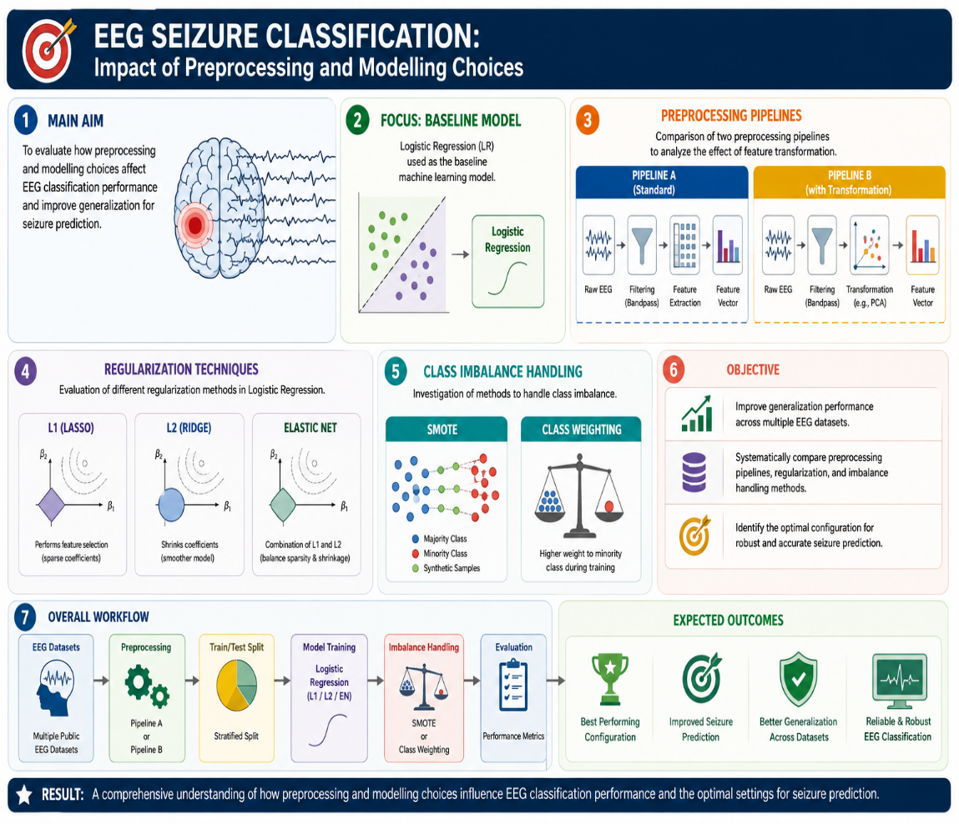
Aim and Objectives
The main aim is to evaluate how preprocessing and modelling choices affect EEG classification performance.
The study focuses on logistic regression as a baseline machine learning model.
It compares two preprocessing pipelines to analyze the effect of feature transformation.
It evaluates L1, L2, and Elastic Net regularization techniques.
It also investigates class imbalance handling methods such as SMOTE and class weighting.
The objective is to improve generalization performance across multiple EEG datasets.
Finally, the study identifies optimal configurations for seizure prediction tasks.

Slide 5
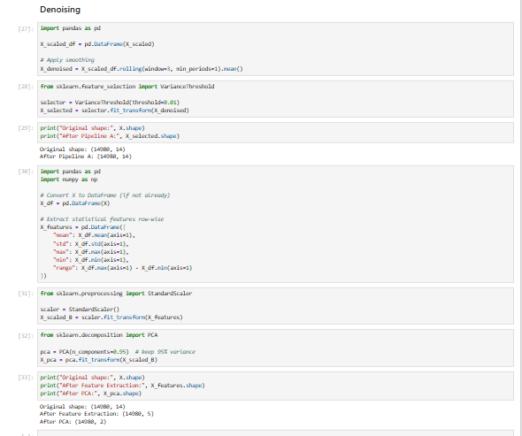
Dataset Preparation
Three EEG datasets were used including Eye State, Seizure Recognition, and EEG dataset.
These datasets contain both time-series EEG signals and extracted numerical features.
The total dataset sizes range from approximately 8,000 to 14,980 records.
Class imbalance exists where seizure cases are minority classes in most datasets.
Features include EEG channel readings and statistical signal representations.
These datasets provide diverse conditions for evaluating model robustness.
The variation allows testing of generalization across different EEG environments.

Slide 6
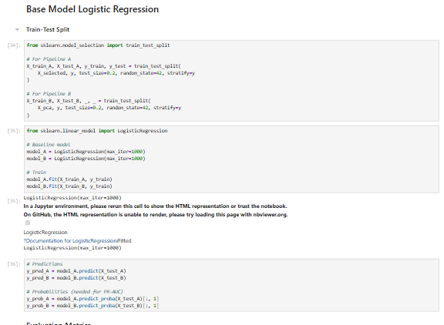
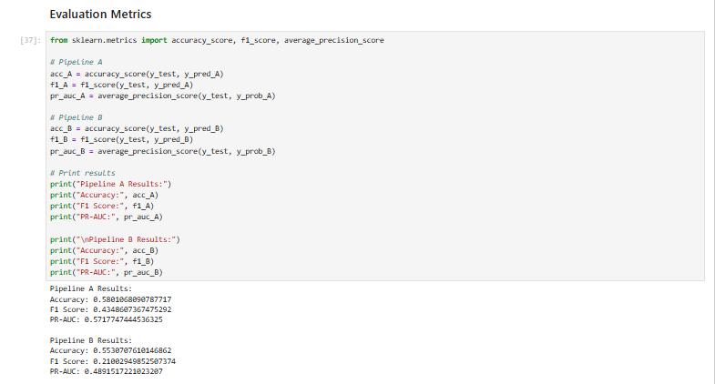
Methodology Overview
The methodology is based on experimental machine learning design.
Logistic regression is used as the primary classification algorithm.
Data is split into training and testing sets for evaluation.
Two preprocessing pipelines are designed and compared.
Regularization techniques are applied to control model complexity.
Class imbalance techniques are used to improve minority class detection.
Performance is evaluated using accuracy, F1-score, and PR-AUC metrics.

Slide 7
Pre-Processing Pipelines
Pre-Processing Pipeline A
Pre-Processing Pipeline B
Pipeline A consists of normalization, noise reduction, and feature selection.
StandardScaler is used to ensure all EEG features are on the same scale.
Noise reduction helps remove irrelevant variations in EEG signals.
Feature selection removes redundant or weakly important variables.
This pipeline preserves original EEG structure and interpretability.
It improves model stability by reducing unnecessary complexity.
Pipeline A generally provides stronger predictive performance.
Pipeline B consists of feature extraction, scaling, and PCA transformation.
Feature extraction converts raw EEG signals into simplified statistical features.
Scaling ensures equal contribution of all extracted features.
PCA reduces dimensionality by transforming data into principal components.
This pipeline improves computational efficiency but reduces interpretability.
Some EEG signal information may be lost during transformation.
Pipeline B is faster but less accurate compared to Pipeline A.

Slide 8
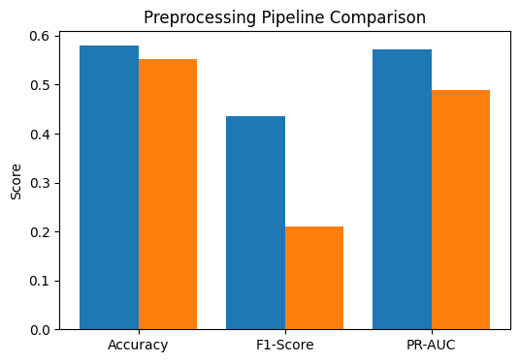
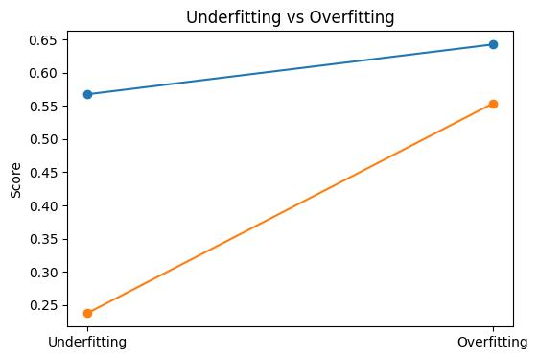
Results-Pipeline Comparison
Pipeline A achieved higher accuracy, F1-score, and PR-AUC than Pipeline B.
Pipeline A recorded accuracy of 0.5801 and F1-score of 0.4349.
Pipeline B showed reduced performance with F1-score of 0.2100.
This shows that feature preservation is more effective than PCA compression.
Pipeline A better captures seizure-related EEG patterns.
Pipeline B loses some predictive information during dimensionality reduction.
Overall, Pipeline A is the best preprocessing approach.

Slide 9
Result-Regularization & Imbalance
L1 regularization achieved the highest performance with accuracy 0.6245.
L2 regularization showed stable but slightly lower results.
Elastic Net provided balanced but moderate performance.
SMOTE improved minority seizure detection with highest PR-AUC.
Class weighting also improved balanced classification performance.
Under sampling reduced dataset size but slightly reduced accuracy.
Overall, L1 and SMOTE performed best in combination.
Regularisation Method | Accuracy | F1-Score
L1 Regularisation | 0.6245 | 0.5182
L2 Regularisation | 0.5801 | 0.4349
Elastic Net | 0.5734 | 0.4264
Imbalance Handling Technique | F1-Score | PR-AUC
Class Weighting | 0.5331 | 0.5695
SMOTE Oversampling | 0.5323 | 0.571
Random Under-Sampling | 0.5356 | 0.5682

Slide 10
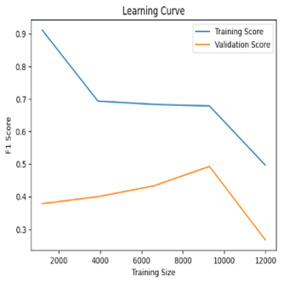
Learning Behaviour Analysis
Under fitting occurs when the model is too simple to learn patterns.
It results in low accuracy and poor F1-score performance.
Overfitting occurs when the model memorizes training data.
It shows high training accuracy but low validation performance.
The study observed an accuracy gap of around 8% to 12%.
Balanced regularization reduces both overfitting and under fitting issues.
Proper model tuning is essential for EEG generalization.

Slide 11
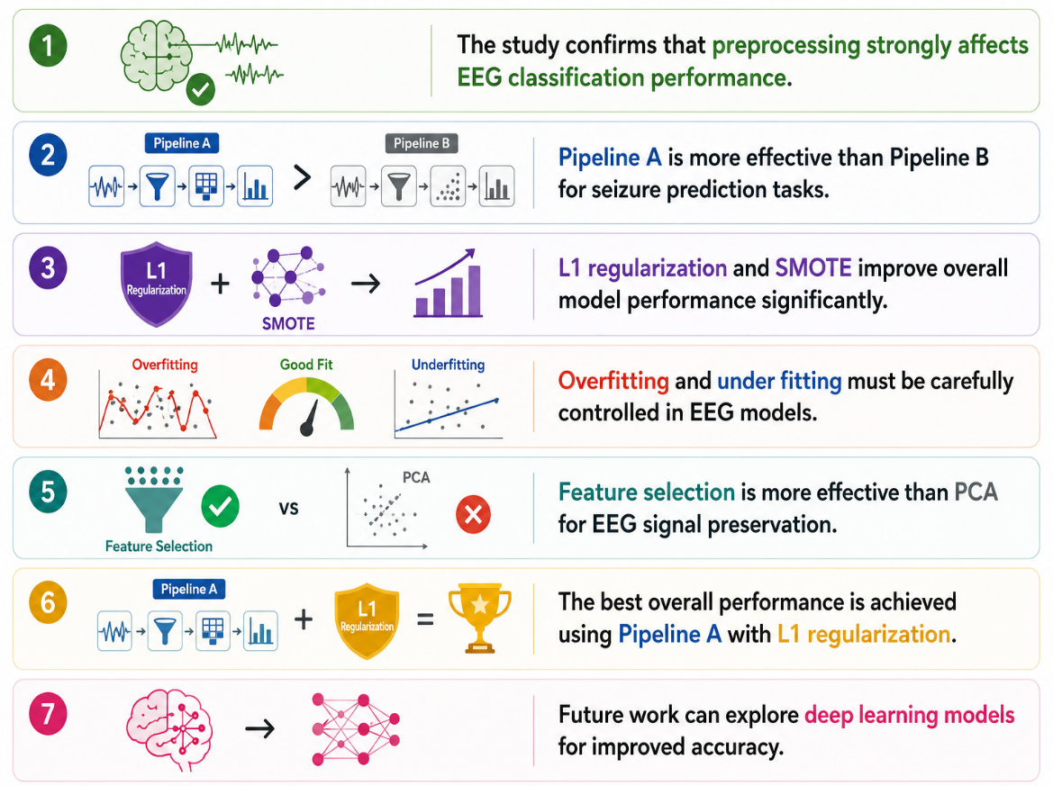
Conclusion
The study confirms that preprocessing strongly affects EEG classification performance.
Pipeline A is more effective than Pipeline B for seizure prediction tasks.
L1 regularization and SMOTE improve overall model performance significantly.
Overfitting and under fitting must be carefully controlled in EEG models.
Feature selection is more effective than PCA for EEG signal preservation.
The best overall performance is achieved using Pipeline A with L1 regularization.
Future work can explore deep learning models for improved accuracy.

